Slide 1
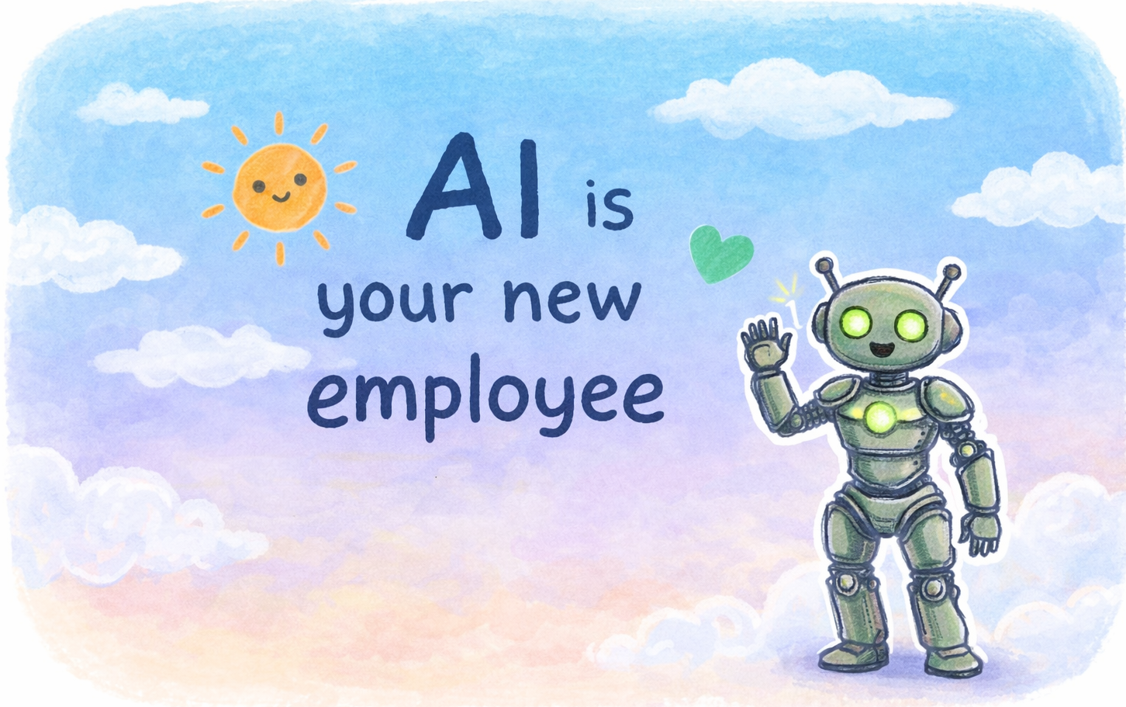

Slide 2
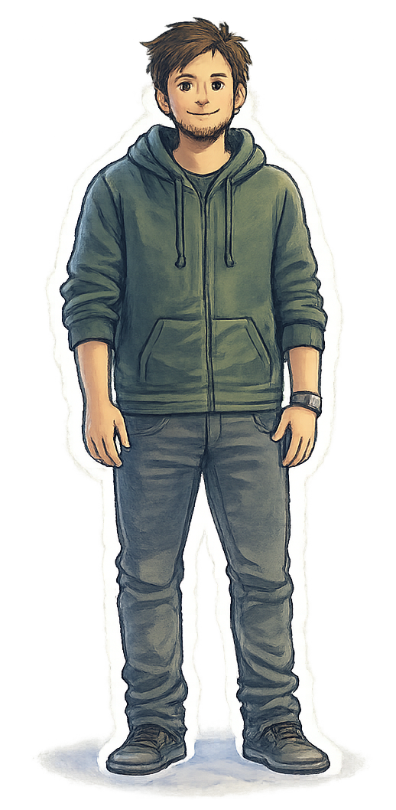
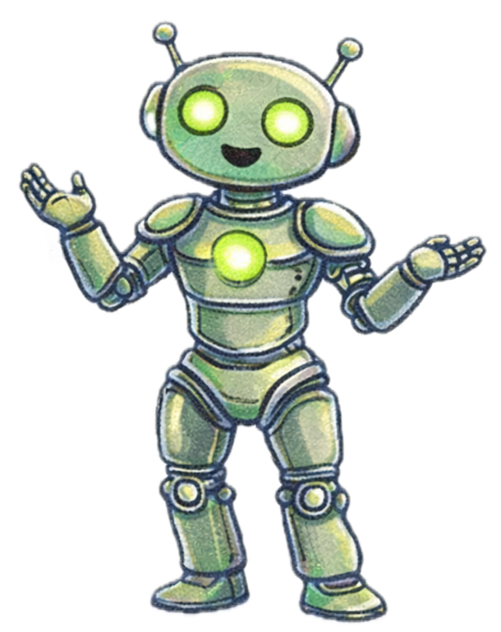
Skilled
Capable
Intelligent
Useless

Slide 3
Learn

Slide 4
Amnesia

Slide 5
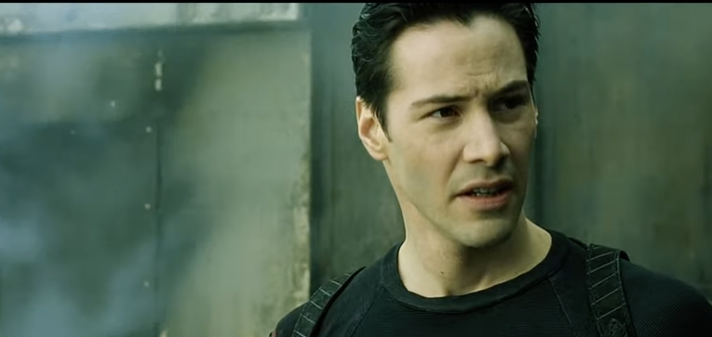
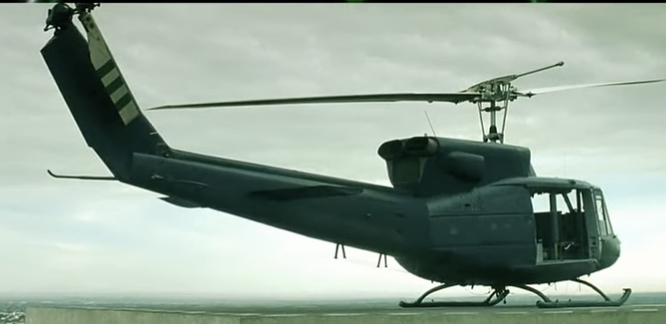
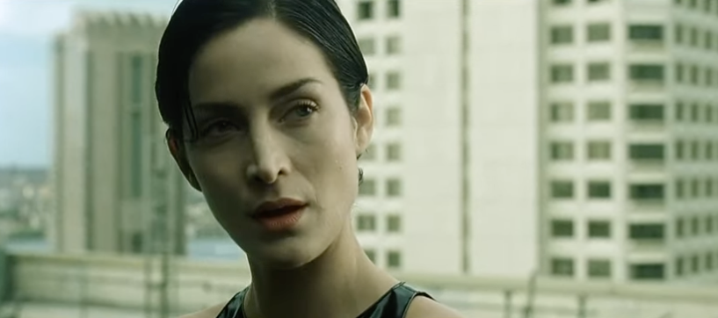
Can you fly that thing?
Not yet…

Slide 6

Knowledge Documents

Slide 7
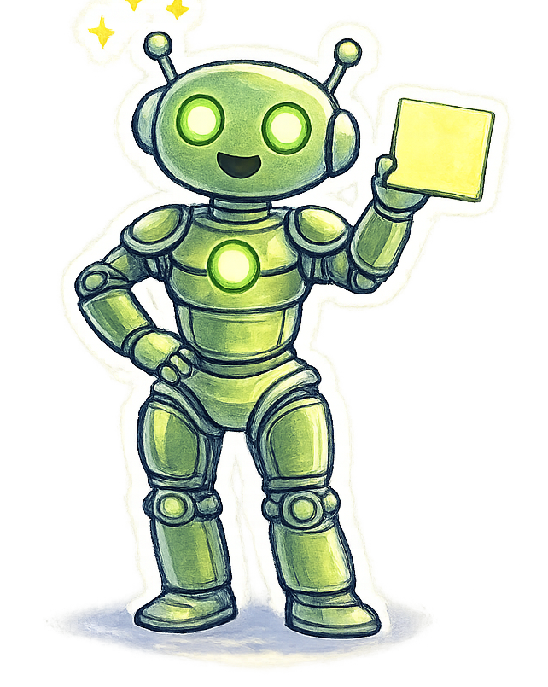

?

Slide 8

Thank you
@LlewellynFalco

